Slide 1


An Implementation of Efficient Low Cost 2D Median Filter

Slide 2
MEET THE TEAM
B Vivek Vardhan
C Sathwik Reddy
S Narendra Chowdary
N V Kishore
P Purna Aditya
AP18110020209
AP18110020210
AP1810020201
AP18110020229
AP18110020235

Slide 3
Our UROP Journey
Literature Survey
Implementation
Problem Identification
Finding Solution
Publication

Slide 4

Presentation format
Introduction
Architecture and simulation results
01
03
02
Sub-Modules
04
Conclusion

Slide 5
Mean
LPF
Wavelet Transform
Gaussian
LPF
Median
Filter
Fourier Transform
Freq Domain
Time Domain
HPF
Bilateral
Wavelet Transform
Welner
HPF

Slide 6
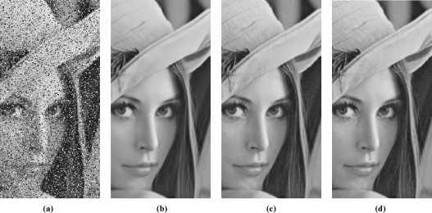
Introduction
The 2D median filter plays an important role in image processing for noise removing. To enhance the operating speed, hardware implementation of median filter on field programmable gate arrays (FPGA) or application specific IC (ASIC) are necessary and inevitable.
Here, we presents a low-cost and high-throughput hardware design for two-dimensional (2D) median filter.

Slide 7
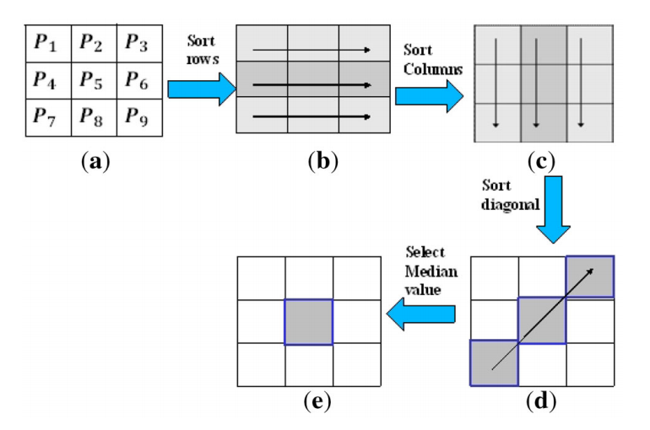
Procedure

Slide 8
Sub-Modules
Parallel Three Valued Sorting Module
Dual Maximums Module
PTVS
D-Max
Median Filter
DPTVS
D-Min
Dual-Parallel Three Valued Sorting Module
Dual-Minimum Module

Slide 9
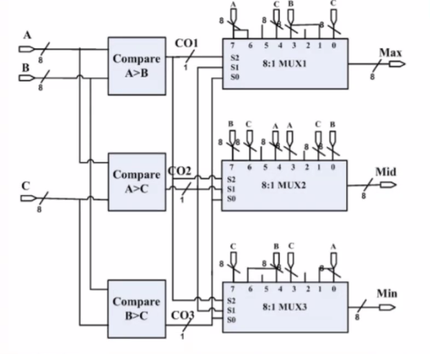
PTVS Module:
Input: {D_{i}, D_{i+1}, D_{i+2}} /*three N-bit values under sorting*/ Output: {High, Median, Low}
Transient Circuit

Slide 10


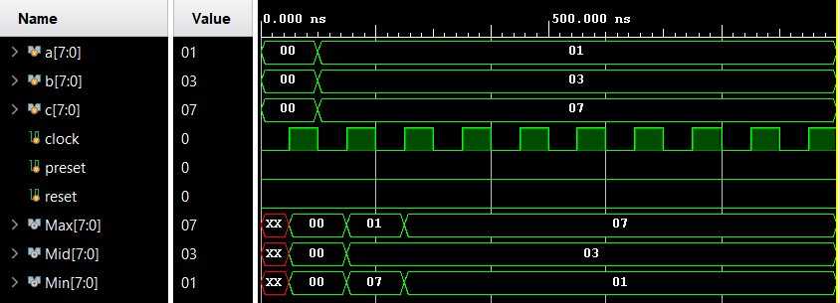
Implementation of PTVS
Software Used
Simulation Results

Slide 11
Dual-Parallel Three Valued Sorting Module I/p’s and o/p’s
Input: {D_{i}, D_{i+1}, D_{i+2}, D_{i+3}} /*four N-bit values under sorting*/ Output: {High₁, Median₁, Low₁} for D_{i}, D_{i+1}, D_{i+2} {High₂, Median₂, Low₂} for D_{i+1}, D_{i+2}, D_{i+3}

Slide 12
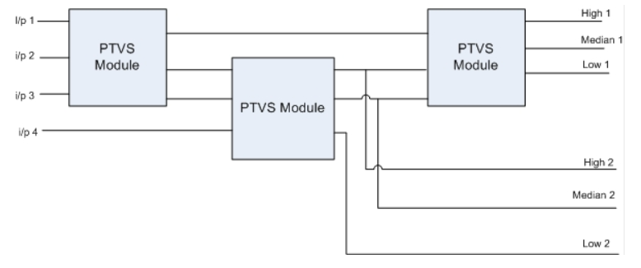
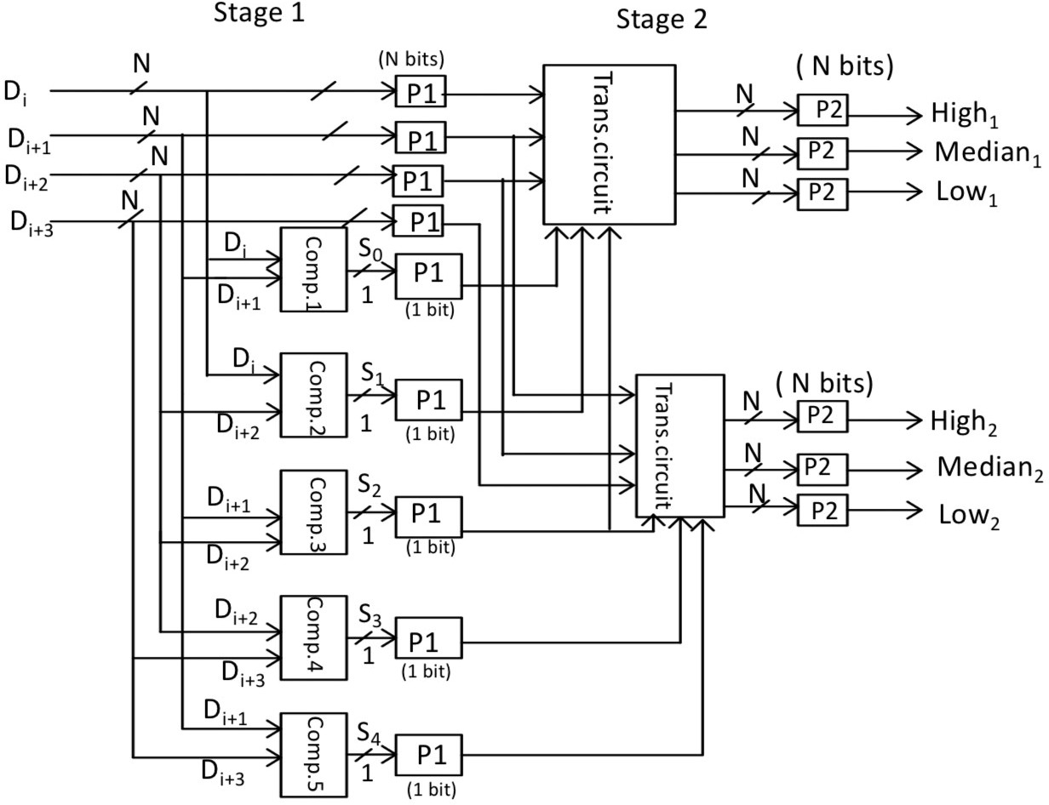
1
Ways to Implement DPTVS
2

Slide 13
Dual Max/Min Searching modules (DMAXS/DMINS)

Slide 14
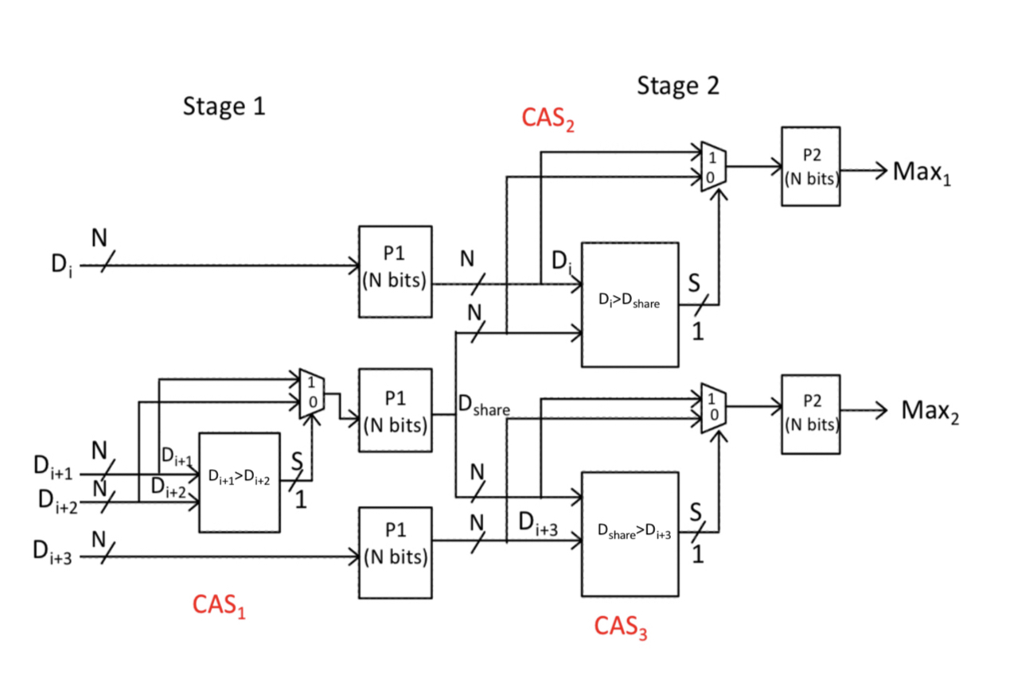
Input: {Di, D_{i+1}, D_{i+2,} D_{i+3}} /*four N-it values under searching*/
Output:
{Max₁} for D_{i}, D_{i+1,} and D_{i+2}
{Max₂} for D_{i+1}, D_{i+2} and D_{i+3}

Slide 15
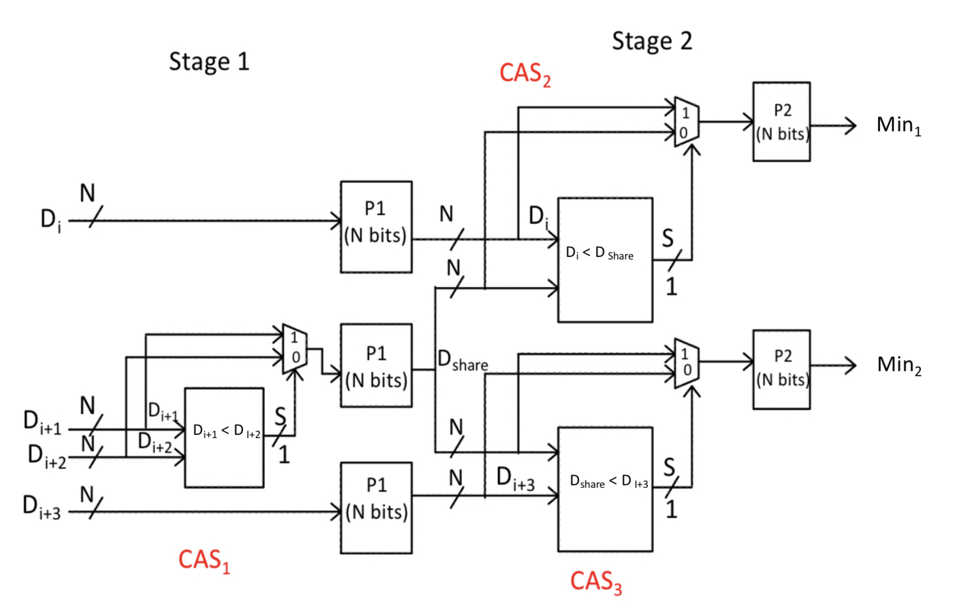
Input: {Di, D_{i+1}, D_{i+2,} D_{i+3}} /*four N-it values under searching*/
Output:
{ Min₁} for D_{i}, D_{i+1,} and D_{i+2}
{ Min₂} for D_{i+1}, D_{i+2} and D_{i+3}

Slide 16
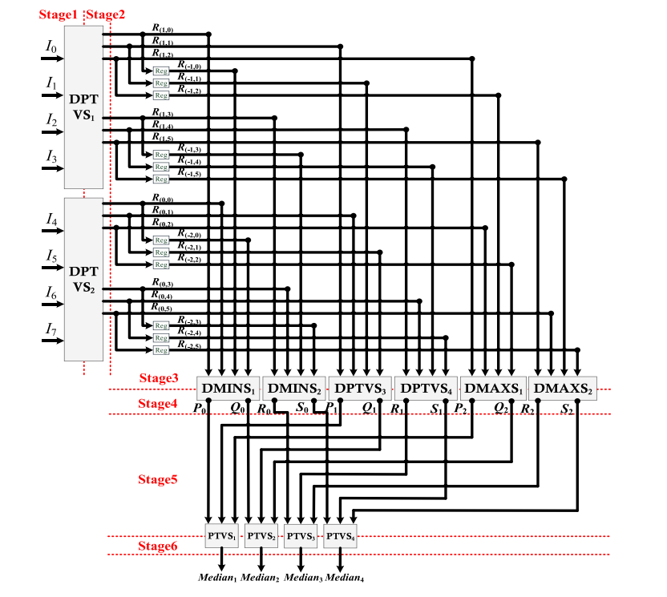
Hardware Architecture of Proposed 2D Filter:
This is the median filter circuit that we have implemented in our project.
This is a 4 x 4 mask median values finding circuit.

Slide 17
Stages:
In this we have six stages :
Stage 1: Pixels as inputs of DPTVS
Stage 2: Output of DPTVS
Stage 3: Input to the D Min, D max, DPTVS
Stage 4:PQRS are the outputs in stage 4
Stage 5:Inputs to the PTVS module
Stage 6: Median values of 4 x 4 mask

Slide 18
The previous pixels already stored in registers. By combining all, we will get high median low values and it will go through the corresponding module like D-Min, D-Max, DPTVS and we will find median values through PTVS.
Here, we were used, 4 – DPTVS, 2 – D Min, 2 – D Max, 4 – PTVS modules.

Slide 19

Let’s simulate the implementation

Slide 20
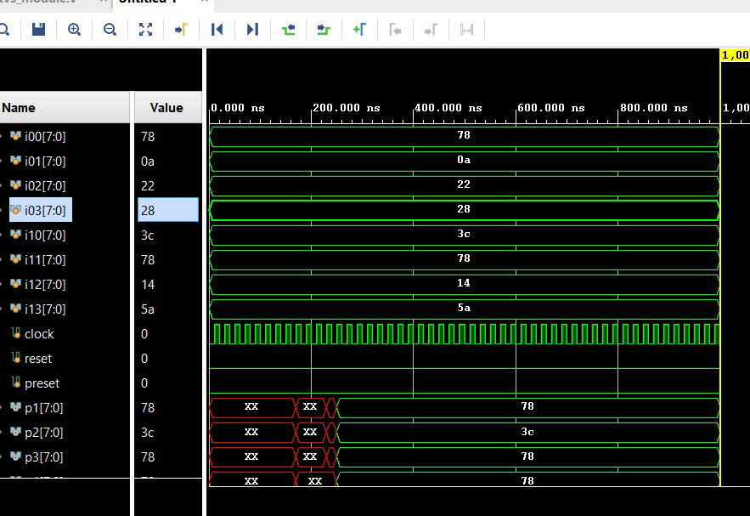
Simulation results of filter

Slide 21
Pros | Cons
Used in Multimedia applications. Easy to implement and used for de-noising. Helps to pipeline registers between row and column processing to increase frequency. Median filter is more effective than mean filter. | Median Filter tends to remove image details when the impulse noise percentage is more than 0.4%. Median filter is not so efficient for additive Gaussian noise removal, it yields to linear filters. One of the major problems with the median filter is that it is relatively expensive and complex to compute.

Slide 22
Conclusion:
This project presents a low latency hardware architecture of the 2-D median filter for image and video processing applications. The PTVS module is used in parallel to design the proposed 2-D median filter, which gives a throughput of1 pixel per clock cycle for the median calculation of the 4*4 window of incoming digital images. The designed PTVS module is faster than the conventional 3-value sorter architecture. The proposed 2-D median filter can be used in real-time image processing applications as its processing time is 1.192 ns. The Proposed Architecture can be extended to design a 3-Dmedian filter.

Slide 23

THANK YOU!
Stay Home Stay Safe…

